Slide 1
NYC Vision Zero Initiative:
Is it working?
January 19, 2023

Slide 2
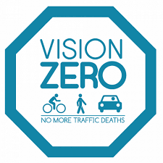
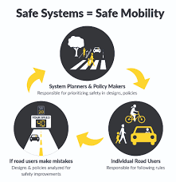
Background
Vision Zero began in Sweden in the mid 1990s
Zero-traffic related deaths by 2020
Successful but leveled off around 2013 with no improvement since
NYC started in January of 2014
Higher penalties for serious infractions (speeding, failure to yield)
Safety zones with reduced traffic patterns, new street designs, elevated crosswalks, designated bike lanes, etc
Public outreach
Legislation to allow localities power over traffic regulations:
Ultimately, reduce speed limits
19 mph - pedestrian safety threshold
43 mph - vehicle (front) collision threshold
31 mph - vehicle (side) collision threshold

Slide 3





Data
Source: NYC Open Data
DoT dynamic dataset
Data includes all reported motor vehicle collisions within the 5 boroughs
Filtered from 01/01/13 - 12/31/19 (1.5M+)
No COVID outliers
Starting before deBlasio initiated the program in 2014

Slide 4
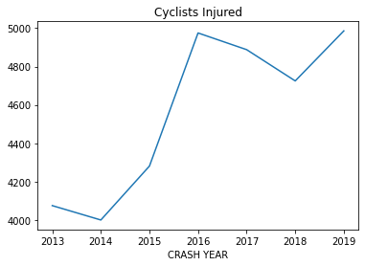
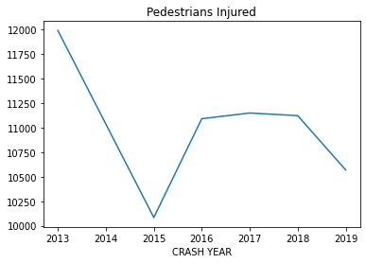
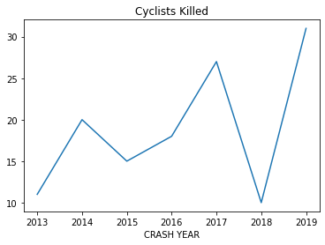
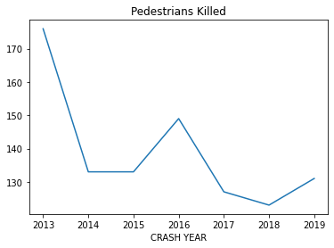
Is it working?
According to the DoT, motor vehicle deaths have decreased steadily since the initiative began in 2014, however…

Slide 5
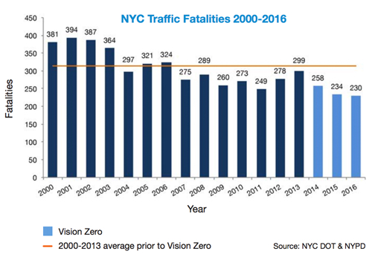
Conclusion:
To achieve zero deaths due to motor vehicle accidents is unrealistic in our current environment.
We’ve been (slowly) improving for over a decade
If the goal is eliminating deaths, Vision Zero is worthwhile
If the goal is preventing collisions, looks like it may be too soon to judge
Is society willing to put up with minor inconveniences for the greater good? for only marginal improvements to these figures?
SOURCE: David Meyer, StreetsBlogNYC https://nyc.streetsblog.org/2017/02/23/taking-stock-of-vision-zero-three-years-in/

